Slide 1
Chapter 8 Tuning Supervised Learners
There are multiple suites of supervised learning algorithms that can be used to model prediction systems through a labelled training data which might predict a real number (in regression) or one or more discrete classes (in classification).
Each method provides a set of features that can be modified or tuned to manipulate the capabilities of the model – which might have a significant effect on the qualities of results thus achieved.

Slide 2
Training and Testing Processes
A machine learning experiment is divided into two primary phases.
The model is first fit on a training dataset.
The training dataset contains training tuples that contain an input vector and the corresponding output.
The predicted quantity is usually called the target.

Slide 3
In the second part, the model is used to predict the targets for another labelled dataset called test dataset.
However, this data is not exposed to the learning algorithm during training – thus, it is unseen by the model.
This provides a way to perform unbiased evaluation of the model.

Slide 4
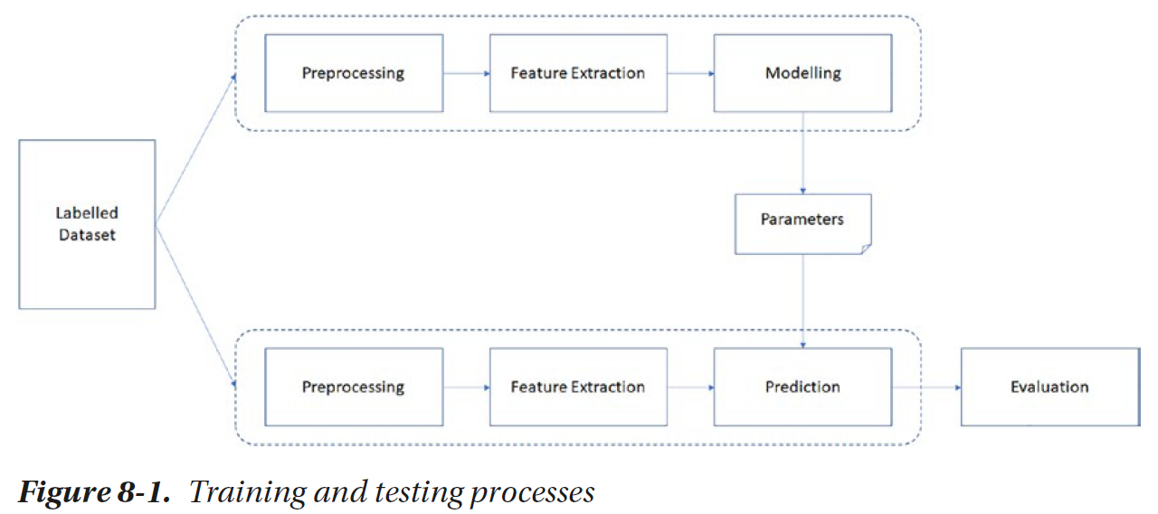

Slide 5
Measures of Performance
Once we create a machine learning model and fit it in a data pipeline to predict results for a previously unseen sample of data, we need to ensure that the model is accurate.
Measuring the quality of results that a classifier model can generate is an important topic that requires sufficient understanding of the model as well as the domain your problem is based on.

Slide 6
Confusion Matrix
Confusion matrix is a simple contingency table that is used to visualize the performance of a classification algorithm which may classify the elements into two or more classes.
In the table, each row represents the items belonging to the actual classes, and each column represents the items belonging to the predicted classes.

Slide 7
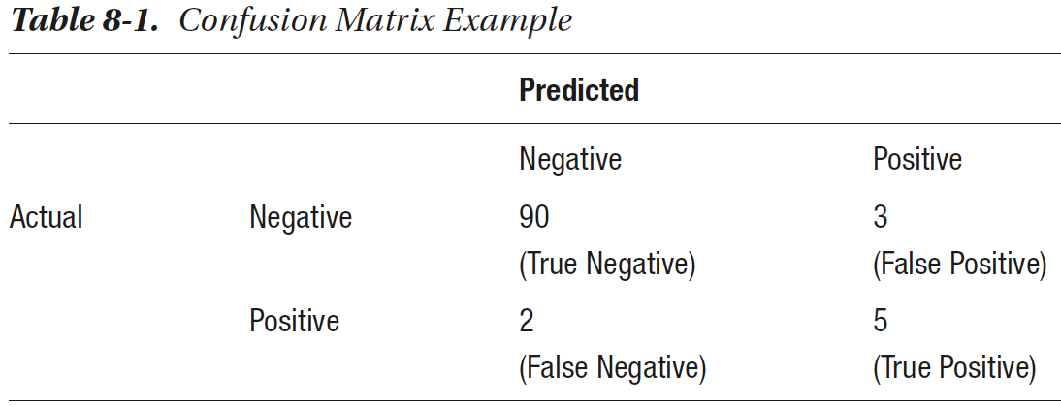

Slide 8
The samples that are correctly labelled as negative are called True Negatives (TN), and the ones that are incorrectly labelled as negative are called False Negatives (FN).
Similarly, the model predicted eight people as positive, out of which five are correctly predicted as positive, thus indicating the True Positives (TP). The three items that are incorrectly labelled as positive but are actually negative are called False Positives (FP).

Slide 9
True Positives and True Negatives amount to the overall accuracy of your model.
False Positives are often called Type 1 Error, and False Negatives are called Type 2 Error.
Though there’s usually a trade-off between the two, which error should you be more concerned about depends on the problem you’re trying to solve.

Slide 10
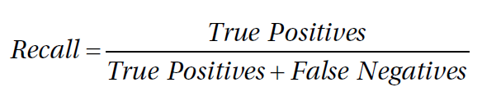
Recall
Recall is a measure that indicates the ratio of positive test data items that are correctly identified out of all the items that are actually positive.

Slide 11
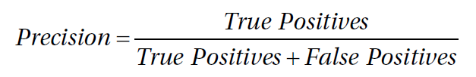
Precision
Precision is the measure that indicates ratio of the number of correctly predicted positive points to the number of all the points that were predicted as positive.

Slide 12
Both precision and recall should be as high as possible.
However, in some cases, we find as we attempt to increase the recall the precision might relatively decrease.

Slide 13
Accuracy
Accuracy is a simple measure that denotes how many items are correctly classified into both the classes.

Slide 14
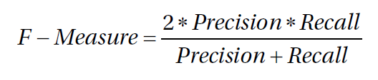
F-Measure
F-measure or F1-Score is a score obtained by taking the harmonic mean of precision and recall to give a general picture of the goodness of the classification model.
Harmonic mean, instead of using the arithmetic mean, penalizes the extreme values more and moves more toward the lower value of the two.

Slide 15
Performance Metrics in Python
Scikit-learn provides three APIs for evaluating the model quality, namely, estimator score method, scoring parameter, and metric functions.
Estimator score method is the model.score() method that can be called for every object of any classifier, regression, or clustering classes.

Slide 16
For the code in this section, we assume that you have created a classifier for Iris flower classification in the previous chapter.
  import pandas as pd
  from sklearn import datasets
  iris = datasets.load_iris()
  iris_data = pd.DataFrame(iris['data'], columns=iris['feature_names'])
  iris_data['target'] = iris['target']
  iris_data['target'] = iris_data['target'].apply( lambda x:iris['target_names'][x] )
  X = iris_data[['sepal length (cm)', 'sepal width (cm)', 'petal length (cm)','petal width (cm)']]
  y = iris_data['target']

Slide 17
  from sklearn.model_selection import train_test_split
  X_train, X_test, y_train, y_test = train_test_split (X,y,test_size=0.20,random_state=0)
  from sklearn.tree import DecisionTreeClassifier
  DT_model = DecisionTreeClassifier(criterion="entropy", max_depth=3)
  DT_model.fit(X_train, y_train)

Slide 18
Now we will import sklearn.metrics so that we can access all the metric functions in this module.
  import sklearn.metrics
Assuming you have trained the model, we will now find predicted class labels for the test dataset.
  y_pred = DT_model.predict(X_test)
  print (y_pred)
This should print the array containing predicted values of all the test data samples.

Slide 19
Print the confusion metrics using
  print(sklearn.metrics.confusion_matrix(y_test, y_pred))
  array([[15, 0, 0],
  [ 0, 10, 1],
  [ 0, 0, 12]], dtype=int64)

Slide 20
sklearn.metrics also contains functions for precision, recall, and F-measure.
All these functions take at least two arguments: the actual class labels and the predicted class labels.

Slide 21
If you have more than two classes, you can give the additional function parameter for average, which may contain one of the following values:
  binary: Default, the function only reports the results for the positive class labels.
  micro: Calculate metrics globally by counting the total true positives, false negatives, and false positives.
  macro: Calculate metrics for each label, and find their unweighted mean. This does not take label imbalance into account.
  weighted: Calculate metrics for each label, and find their average weighted by the number of instances for each label in the test data and counts for the label imbalance.

Slide 22
We can now find the performance metrics discussed in this section at macro level.
  sklearn.metrics.confusion_matrix(y_test, y_pred)
  p = sklearn.metrics.precision_score(y_test, y_pred, average='micro')
  r = sklearn.metrics.recall_score(y_test, y_pred, average='micro')
  f = sklearn.metrics.f1_score(y_test, y_pred, average='micro')
  a = sklearn.metrics.accuracy_score(y_test,y_pred)
  print ("Here're the metrics for the trained model:")
  print ("Precision:\t{}\nRecall:\t{}\nF-Score:\t{}\nAccuracy:\t{}".
  format(p,r,f,a))

Slide 23
Classification Report
Classification report gives most of the important and common metrics required for classification tasks in one single view.
It shows the precision, recall, and f-score for each class along with the support, or the number of actual testing samples that belong to the class.
  print (sklearn.metrics.classification_report(y_test, y_pred))

Slide 24
Cross Validation
We divide the labelled dataset into two components – namely, training set and validation (or testing) set.
It is a good idea to come with a rotation of training and testing parts to be able to determine how well will the model generalize to an independent dataset.

Slide 25
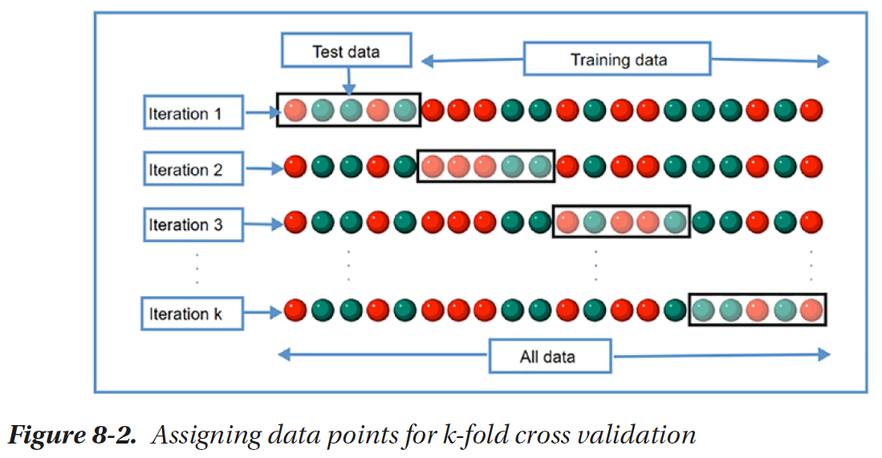

Slide 26
Over the k iterations, we will obtain k metrics, which can be averaged to find a more generalizable metric that can be used to tune the hyperparameters.

Slide 27
Why Cross Validation?
If we tweak a model based on a static test set, it is possible to overoptimize and overfit on the test set which may not generalize to more unseen data.
The knowledge about the test set can indirectly creep into the model, and evaluation metrics are not generalized.
Thus, multiple folds of the data provide an opportunity to not tune the results on one static set.

Slide 28
Cross Validation in Python
For cross validation, we will not consider randomly created train-test splits as in previous examples but work with the features and the values.
  import pandas as pd
  from sklearn import datasets
  iris = datasets.load_iris()
  X = pd.DataFrame(iris['data'], columns=iris['feature_names'])
  y = iris['target']

Slide 29
We will now use fivefold cross validation to create multiple splits:
  from sklearn.model_selection import KFold
  kf = KFold(n_splits=5)
  kf.get_n_splits(X)

Slide 30
This initiates fivefold cross validation that will produce five splitting iterations, each containing approximately 120 elements in training set and 30 elements in testing set.
We can look at the index of the elements that are chosen for training and testing in each iteration as follows:
  for i, (train_index, test_index) in enumerate(kf.split(X)):
    print ("Iteration "+str(i+1))
    print("Train Indices:", train_index, "\nTest Indices:", test_index,"\n")

Slide 31
We can use the data points in each iteration to fit the model:
  score_history = []
  for train, test in kf.split(X, y):
    clf = DecisionTreeClassifier()
    clf.fit(X.values[train,:], y[train])
    y_pred = clf.predict(X.values[test,:])
    score_history.append(clf.score(X.values[test,:], y_pred))

Slide 32
ROC Curve
Various classification algorithms can be configured to produce a class label based on a predefined threshold on the probability of the data item belonging to a class.
The classifier’s predictions can strongly differ based on the threshold. This indirectly affects the precision and recall, sensitivity and specificity.
In the following experiments, we will train a logistic regression model and find True Positive Rate and False Positive Rate based on classification output for different threshold of the model.

Slide 33
from sklearn.datasets import make_moons
X1, Y1 = make_moons(n_samples=1000, shuffle=True, noise=0.1)
import matplotlib.pyplot as plt
plt.figure(figsize=(8, 8))
plt.scatter(X1[:, 0], X1[:, 1], marker='o', c=Y1, s=25, edgecolor='k')
plt.show()

Slide 34
For generating less complex dataset, you can use
  from sklearn.datasets import make_classification
  X1, y1 = make_classification(n_classes=2, n_features=2, n_redundant=0, n_informative=1, n_clusters_per_class=1)

Slide 35
We will train a logistic regression model.
  from sklearn.linear_model import LogisticRegression
  from sklearn.model_selection import train_test_split
  X_train,X_test,y_train,y_test = train_test_split(X1,y1,test_size=0.2,random_state=42)
  logreg = LogisticRegression()
  logreg.fit(X_train,y_train)

Slide 36
Instead of predict() method, we can call predict_proba() method that produces each point belonging to the second class (class label=1).
  logreg.predict_proba(X_test)
We will take one of the columns for the probability and manipulate the threshold and monitor the effect it has on TPR and FPR.
  y_pred_proba = logreg.predict_proba(X_test)[:,1]
  from sklearn.metrics import roc_curve
  [fpr, tpr, thr] = roc_curve(y_test, y_pred_proba)

Slide 37
The objects returned from the last statement can be used to analyze the effect of setting different thresholds.
The curve can be traces across multiple values of threshold.
Before that, we will introduce one more metric, which takes the false positive rates and true positive rates and, based on them, computes the area under the curve thus generated.
  from sklearn.metrics import auc
  auc (fpr, tpr)

Slide 38
Let’s plot the graph.
  import matplotlib.pyplot as plt
  plt.figure()
  plt.plot(fpr, tpr, color='coral', label = 'ROC Curve with Area Under Curve ='+str(auc (fpr, tpr)))
  plt.xlabel('False positive Rate (1 - specificity)')
  plt.ylabel('True Positive Rate ')
  plt.legend(loc='lower right')
  plt.show()

Slide 39
Overfitting and Regularization
We can fine-tune the models to fit the training data very well.
In this process, we often play with several properties of the algorithms that may directly manipulate the complexity of the models.

Slide 40
Let’s try to play with linear regression and use a more complex model to fit the training data points from the last chapter more precisely.
We will create a new set of features to take simple arithmetic transformation of the independent variable and fit linear regression based on them.
This method is called polynomial regression.

Slide 41
  import numpy as np
  import pandas as pd
  from sklearn.linear_model import LinearRegression
  from sklearn.preprocessing import PolynomialFeatures
  data = pd.DataFrame({"marks":[34,51,64,88,95,99], "salary":[3400, 2900, 4250, 5000, 5100, 5600]})
  X = data[['marks']].values
  y = data['salary'].values
  poly = PolynomialFeatures(3)
  X1 = poly.fit_transform(X)

Slide 42
  reg = LinearRegression()
  reg.fit(X1, y)
  X_seq = np.linspace(X.min(),X.max(),100).reshape(-1,1)
  X_seq_1 = poly.fit_transform(X_seq)
  y_seq = reg.predict(X_seq_1)
  import matplotlib.pyplot as plt
  plt.figure()
  plt.scatter(X,y)
  plt.plot(X_seq, y_seq,color="black")
  plt.show()

Slide 43
You can see that we can increase the complexity and the predictions fit the training data more closely, thus reducing the overall error and improving the accuracy.
This looks promising but might be misleading.

Slide 44
  X_seq = np.linspace(0,100,100).reshape(-1,1)
  X_seq_2 = poly.fit_transform(X_seq)
  y_seq = reg.predict(X_seq_2)
  plt.figure()
  plt.scatter(X,y)
  plt.plot(X_seq, y_seq,color="black")
  plt.show()

Slide 45
Here in Figure 8-6, we tried to increase the complexity of the model so that it captures the training data better.
However, this led to unexpected errors for the data that wasn’t present in the real data.
This is called overfitting.

Slide 46
If we instead reduce the number of parameters, say, 1, we are drastically reducing the complexity of the model, and we will be able to capture less details from the training data.
In our example, the model with only one parameter will return the average salary based on the training data, and thus, a horizontal line parallel to the x axis will represent the predictions as shown in Figure 8-7.
That is, the model will predict the same salary regardless of the marks a student attains.
This is called underfitting.

Slide 47
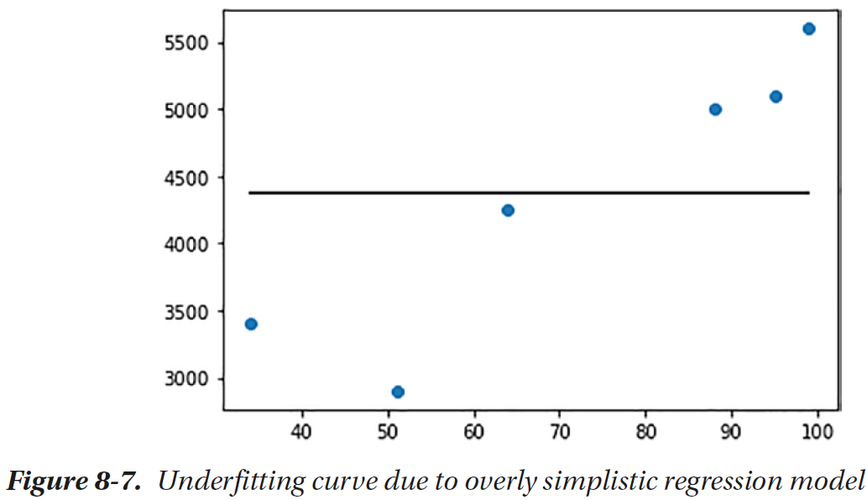

Slide 48
Bias and Variance
Bias and variance are the properties of a model that arise due to either oversimplicity or overcomplexity of our model.
Bias, in general, represents how far a model’s predictions are compared to the actual values.
A model with high bias means that the model is overly simple, and the assumptions it has learned are too basic.
For that reason, the model isn’t able to properly capture the necessary patterns in the data. Thus, the model has high error while training, as well as while predicting.

Slide 49
Variance represents how sensitive the model is to fluctuations in the data.
Say, we have a data point that represents a student who obtained 35 marks and a salary of $6000 and another data point for a student who obtained 34 marks and a salary of $2000, and the system tries to learn the difference from both; this can cause huge difference in how the predictions are generated.

Slide 50
When the variance is high, the model will capture all the features of the dataset, including the noise and randomness. Thus, it becomes overly tuned.
However, when it encounters unseen data, it might yield unexpectedly poor results.
Such a model yields a low training error; however, the error is quite high while testing.

Slide 51
We need to find a balance between bias and variance in order to come up with a model that is sensitive to patterns in our data while also being able to generalize to new unseen data. The trends in error with respect to model complexity are shown in Figure 8-8.

Slide 52
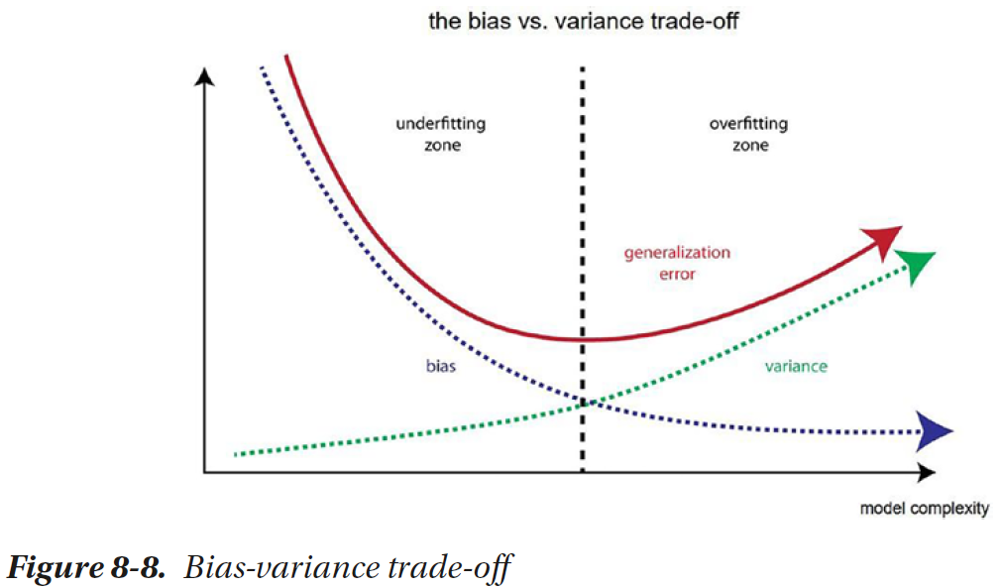

Slide 53
Regularization
A way is to manipulate the cost function that penalizes overcomplexity in the model in order to find the right parameters instead of explicitly limiting the numbers of parameters to learn.

Slide 54
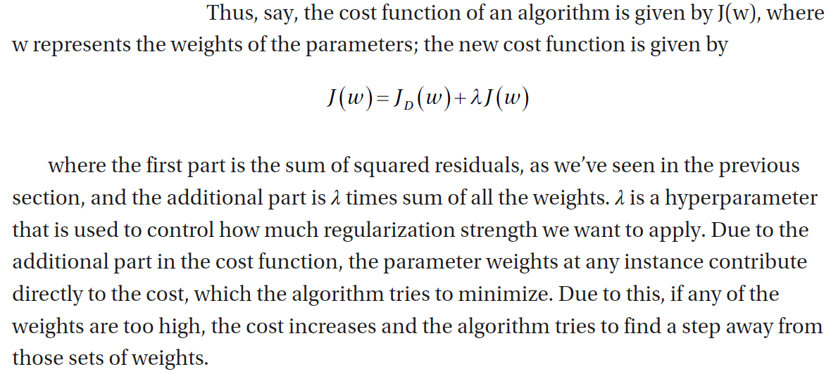

Slide 55
Eventually, we reach a middle ground where the model is complex enough to capture the essence of the structure of the training data while penalizing over complexity so that we avoid learning from extreme outliers and noise.

Slide 56
L1 and L2 Regularization
Regularization is a technique that discourages learning a more complex or flexible model, so as to avoid the risk of overfitting by manipulating the cost function to avoid learning weights that are too high.

Slide 57
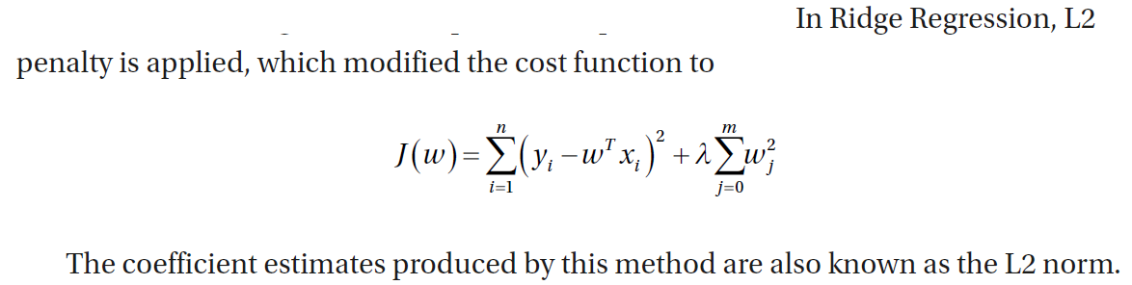

Slide 58
  import numpy as np
  import pandas as pd
  from sklearn.linear_model import LinearRegression, Lasso, Ridge
  from sklearn.preprocessing import PolynomialFeatures
  import matplotlib.pyplot as plt
  data = pd.DataFrame({"marks":[34,51,64,88,95,99], "salary":[3400, 2900,4250, 5000, 5100, 5600]})
  X = data[['marks']].values
  y = data['salary'].values

Slide 59
  fig, axs = plt.subplots(1,3, figsize=(15,5))
  methods = ['Polynomial Regression', 'Lasso Regression alpha=1', 'RidgeRegression alpha=1']
  for i in [0,1,2]:
  poly = PolynomialFeatures(3)
  X1 = poly.fit_transform(X)
  if i==0:
  reg = LinearRegression()
  reg.fit(X1, y)
  if i==1:
  reg = Lasso(alpha=1)
  reg.fit(X1, y)

Slide 60
  if i==2:
  reg = Ridge(alpha=1)
  reg.fit(X1, y)
  X_seq = np.linspace(0,X.max(),100).reshape(-1,1)
  X_seq_1 = poly.fit_transform(X_seq)
  y_seq = reg.predict(X_seq_1)
  axs[i].scatter(X,y)
  axs[i].plot(X_seq, y_seq,color="black")
  axs[i].set_title(methods[i])
  plt.show()

Slide 61
In this code example, we reattempt the problem of predicting students’ salary based on the marks they obtained.
Here, we have first converted the only independent variable (marks) into polynomial features and then trained three models based on that.
The first one is regression without regularization, the second one is Lasso Regression, and the third one is Ridge Regression. The effect of the two techniques is evident from the regression line they produce as shown in Figure 8-9.

Slide 62
Hyperparameter Tuning
While approaching a machine learning problem, you have to engineer and select the right features, pick the algorithm, and tune the selected algorithm (or algorithms) for the hyperparameters they are affected by.
The terms hyperparameters and parameters can’t be used interchangeably.
Parameters are the weights a model learns during learning phase.
Hyperparameters are the externally controlled elements that affect how and what the model learns.

Slide 63
You might often face the choices like the following:
  –– “K” in K-nearest neighbors
  –– Regularization strength in Ridge Regression and Lasso Regression
  –– Maximum depth of a decision tree
  –– Learning rate for gradient descent

Slide 64
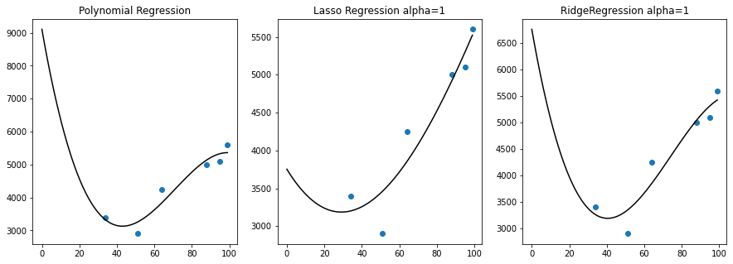

Slide 65
Effect of Hyperparameters
We will do a simple experiment to see how closely we fit a synthetic dataset using the first two columns based on the hyperparameters we can tune for logistic regression.
Let’s create a dataset using Scikit-learn’s make classification functionality.
  from sklearn.datasets import make_classification
  X, y = make_classification(n_samples=400, n_features=2, n_informative=2, n_redundant=0)
We will need to create separate training dataset and test dataset for analyzing the accuracy.
  from sklearn.model_selection import train_test_split
  X_train, X_test, y_train, y_test = train_test_split(X,y, test_size=0.3)

Slide 66
Now we will use logistic regression with polynomial features. We will iteratively try different polynomial degree and see the difference it makes in the accuracy.
  accuracy_history = []
  from sklearn.linear_model import LogisticRegression
  import sklearn.metrics
  for i in range(1,15):
  poly = PolynomialFeatures(i)
  X1 = poly.fit_transform(X_train)
  reg = LogisticRegression(max_iter=100)
  reg.fit(X1, y_train)
  X1_test = poly.transform(X_test)
  y_pred = reg.predict(X1_test)
  accuracy_history.append(sklearn.metrics.accuracy_score(y_test, y_pred))

Slide 67
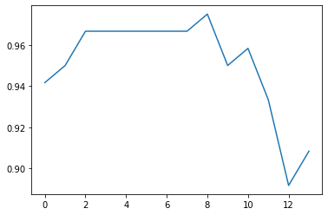
Let’s plot the accuracy:
  import matplotlib.pyplot as plt
  plt.plot(accuracy_history)

Slide 68
We can see in Figure 8-10 that the accuracy increases from degree 5 to degree 7 and then decreases again. Based on this analysis with only one hyperparameter, which is the degree of the polynomial, find the hyperparameter value that yields the best accuracy.

Slide 69
If we have multiple hyperparameters, we have to evaluate the model for multiple possible values for each hyperparameter. Let’s look at the scenario for creating decision tree classifier. These are some of the hyperparameters you can tune:
  criterion: Either Gini based or entropy based.
  max_depth: Maximum depth of a tree.
  min_samples_split: Minimum number of samples that are required to split a node. It can be either an integer representing the number or a float that represents a fraction of total samples.
  min_samples_leaf: Minimum number of samples that should be present in both right leaf and left leaf.

Slide 70
We discussed the working of decision tree in the previous chapter. You can see that such decisions can impact the quality of end results. Let’s say w
  criterion: Gini, entropy (two possible values)
  max_depth: None, 5, 10, 20 (four possible values)
  min_samples_split: 4, 8, 16 (three possible values)
  min_samples_split: 4, 8, 16 (three possible values)e have the following possibilities:

Slide 71
By considering all the options, we will build up to 2x4x3x3 = 72 decision trees, out of which, we will select the one that gives the best metrics.
It is possible to make the selections with the use of multiple loops.
Scikit-learn provides ready-to-use implementations to exhaust all the possibilities (grid search) and test random possibilities (random search).

Slide 72
Grid Search
Grid search, or parameter sweep, is the process of searching through a specified subset of hyperparameter spaces exhaustively.

Slide 73
Random Search
Rather than exhaustively searching for all the combinations in the parameter space, random search selects random possibilities and selects the best model accordingly.

Slide 74
Summary
This chapter has provided us with the essentials that will be used in any machine learning experiment to evaluate and tune the models. In the next chapter, we will study more supervised learning methods.

